Slide 1
Modelling Potential Effects Of Climate Change On Marine Food Chain and Marine Mammals with NetLogo
Keywords: Agent-based Modelling · NetLogo · Project Socially Aware Computing · Oceanography and Marine Biology · Marine Ecosystems · Climate Change · Agent-Based Modelling and Simulation · Climate Modelling
*********

Slide 2
RESEARCH QUESTION
Introduction
- Turtles (and Breeds)
- Patches
Methods
- Overview
- Measurements
Results and Results Analysis
Discussion and Conclusion
Further Research
References
“How climate changes affect the survival of Cetaceans directly and indirectly and how climate changes affect the balance of the local marine ecosystem?”
HYPOTHESIS
The hypothesis of this research question is that compare to the default value of this model, which the whole ecosystem is not affected by climate change and relatively balanced, the higher the water temperature that caused by climate change, the faster the marine ecological equilibrium being disturbed, and the extinction of predators would also be accelerated.
Another hypothesis is that low water temperature will accelerate the extinction of dolphins, maintain the ecological balance for a longer time compared to the high seawater temperature and increase the population of fish during certain time period, but will still result in the mass extinction of the study area at the end.

Slide 3
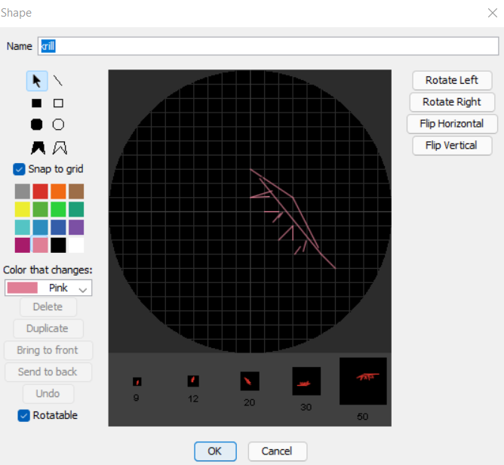
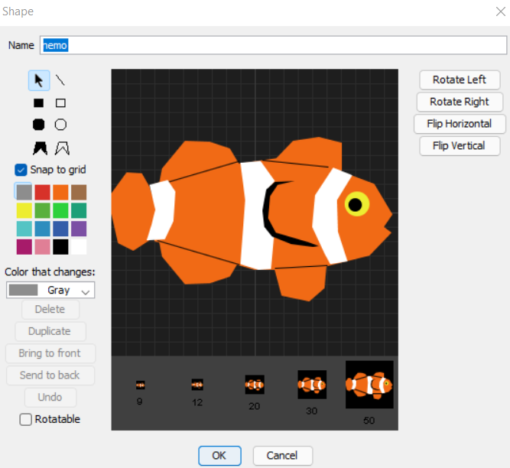
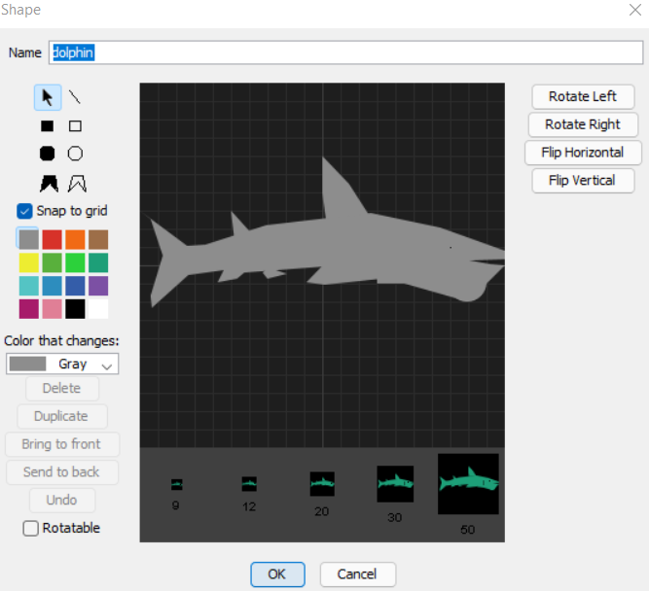
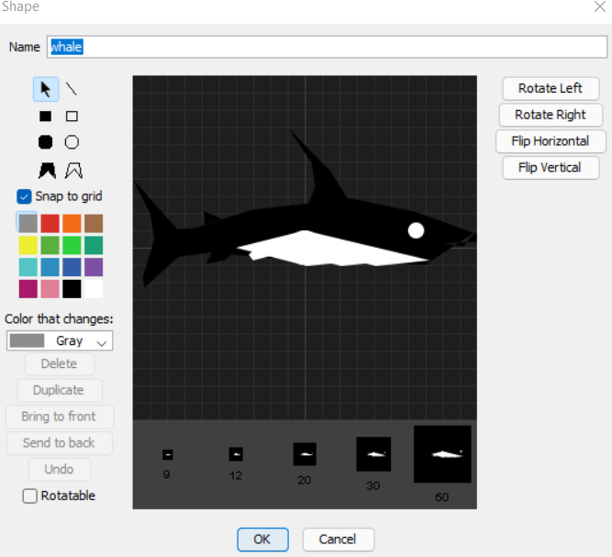
Turtles (and Breeds)
apex predators
tertiary consumers
secondary consumers
primary consumers

Slide 4
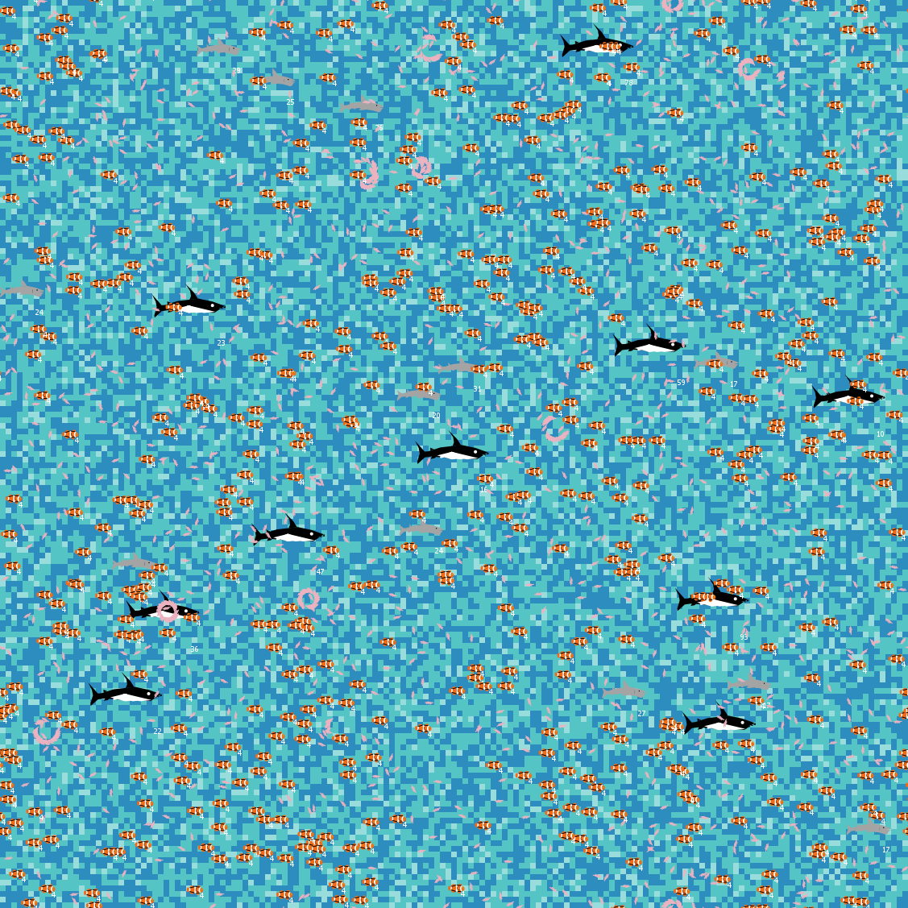
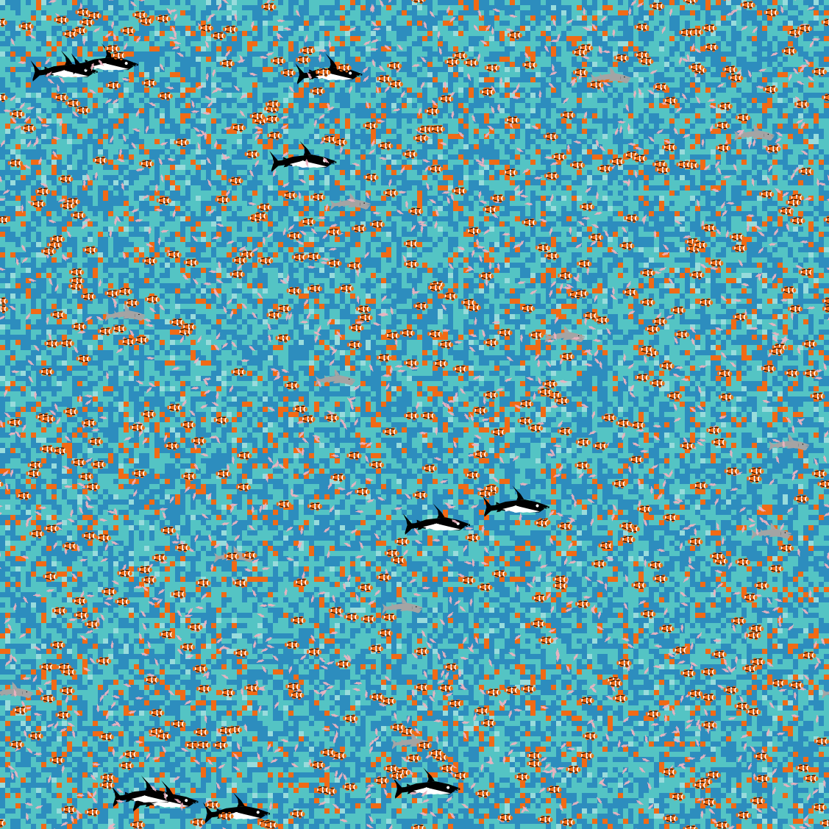
Patches
Marine – Basic.nlogo
Marine - Climate Change.nlogo

Slide 5
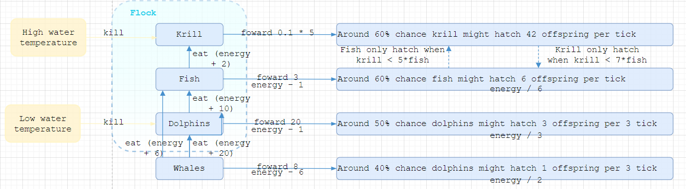
Overview

Slide 6
Result

Slide 7
Discussion and Conclusion
Relations
Back to hypothesis
Findings
Limitations
Further Research

Slide 8
References
Gibson, R., Atkinson, R., and Gordon, J. 2007. Potential Effects Of Climate Change On Marine Mammals. DOI http://dx.doi.org/10.1145/301153.301168.
Silva, Teresa. 2018. Ecology of krill in Icelandic waters.
Klein ES., Hill SL., Hinke JT., Phillips T., Watters . 2018. Impacts of rising sea temperature on krill increase risks for predators in the Scotia Sea. https://doi.org/10.1371/journal.pone.0191011
Gibson, R., Atkinson, R., and Gordon, J. 2007. Potential Effects Of Climate Change On Marine Mammals. DOI http://dx.doi.org/10.1145/301153.301168
Goedegebuure, M., Melbourne-Thomas, J., Corney, S. P., McMahon, C. R., and Hindell, M. A. 2018. Modelling southern elephant seals Mirounga leonina using an individual-based model coupled with a dynamic energy budget. https://doi.org/10.1371/journal.pone.0194950
Wilson, B., Arnold, H., Bearzi, G., Fortuna, C.M., Gaspar, R., Ingram, S., Liret, C., Pribanic, S., Read, A.J.,Ridoux, V., Schneider, K., Urian, K.W., Wells, R.S., Wood, C., Thompson, P.M., and Hammond, P.S. 1999. Epidermal diseases in bottlenose dolphins: impacts of natural and anthropogenic factors.

